Slide 1
NextPay: Your Subscriptions, Simplified
Simran Gahra (200484408 ) Hashir Owais (200483044)
Muhammad Tariq (200464392)
July 31, 2025
Software Testing and Validation (ENSE 375)
Notes:
Introduction by Simran Hello my name is Simran, Hashir, Muhammad This is our project for ENSE 375, Software Testing And Validation, Called NextPay….

Slide 2
Agenda
Introduction
Problem Definition
Design Requirements
Solutions
Testing and Demonstration
Project Management
Conclusion and Future Scope
Notes:
Simran Covers

Slide 3



Introduction
In today's digital age, many users manage multiple recurring services.
This can include entertainment, productivity, utilities, memberships.
Without a way to track them, users may miss cancellations or overspend on subscriptions.
There is a growing need for tools to help monitor, remind, and analyze subscription usage.
Notes:
Muhammad Speaks

Slide 4
Problem Definition
Users are often unaware of how much they are spending on subscriptions across platforms.
Tracking renewals manually is inefficient and prone to errors.
Our project, NextPay, aims to develop a command line Java Application that helps users manage and track subscriptions, offering essential features like cost summaries, filtering and csv exporting - all while enabling thorough JUnit - based software testing.
Notes:
Muhammad

Slide 5
Design Requirements
Functions
Add/Remove subscriptions with billing details.
Providing users the ability to add and remove subscriptions that they have.
Upcoming renewals and total costs
Allow users to see what renewals they have coming and there total monthly costs.
Sorting subscriptions.
Allow users to see there subscriptions in a sorted manner.
Export Data to CSV
Enable users the ability to export there subscription data to a CSV file for viewing.
Notes:
Hashir

Slide 6
Design Requirements
Objectives
User Friendly
Provide a clean, intuitive CLI experience with minimal learning curve.
Local
Create a fully functional offline application without requiring any internet access.
Maintainable
Code is done in a modular and structured manner for easy changes.
Test Driven
Developed using JUnit tests with ENSE 375 testing strategies, TDD, path, boundary, use case to name a few.
Notes:
Hashir

Slide 7
Design Requirements
Constraints
CLI Based
No GUI components in which the application must be fully functional through a command line interface.
Local Storage
Subscription data must be stored and accessed from a local SQLite database.
Testing Compliance & Experience
Must use JUnit and follow testing methodologies such as TDD, taking into account out lack of experience in testing software.
Platform Compatibility
The application is limited and bounded to running on a CLI, on a computer.
Notes:
Simran

Slide 8
External Constraints
Economic Factors: The solution uses free, open source tools reducing development costs to $0. CLI format enables the team to avoid paid hosting platforms such as AWS.
Regulatory Compliance: The user data is stored locally, minimizing any form of exposure to cloud breach or third party risks. CLI structure ensures no unnecessary data collection is being done, ensuring a private design.
Reliability: The testing methodologies that are applied are done to ensure that the application is reliable and can handle foreign inputs and remain maintainable. High code coverage ensure stable performance across modules.
Societal Impacts: Enhances the users financial literacy allowing for control over digital spending. The application is accessible and is not bounded by hardware due to its lightweight CLI format.
Notes:
Muhammad

Slide 9
Solution 1: Full Stack Web Application
Design:
Frontend: React.JS
Backend: Java Spring Boot
Database: PostgreSQL with hibernate
Hosted on AWS EC2 instance.
Analysis:
Scalable and modern, but very complex.
Required multiple testing layers including UI, API, DB, End to End functionality.
Layer of difficulty for JUnit is added.
Rejected due to testing complexity and time constraints.
Notes:
Simran

Slide 10
Solution 2: Mobile Application
Design:
Platform: React Native or Android Studio (Java/Kotlin)
Mobile based design with touch interface.
Analysis:
UI and portability would be greatly improved.
Testing would become difficult due to:
Device and OS variability, Complex UI testing (Espresso/Detox), Harder to implement testing techniques.
Rejected due to lack of support for JUnit based testing, more setup, higher complexity.
Notes:
Muhammad

Slide 11
Solution 3: Final Solution - Java CLI App
Design:
Java Based Command Line Interface
Database: SQLite
Modular Architecture Consisting of UI, App, Logic, Database.
Analysis:
Fully testable using JUnit, complying well with ENSE 375 testing methods.
Simple CLI removes complexity from UI.
Ideal for testing: Boundary Value, Equivalence Class, Use Case, Path and Data flow, State Transition, Decision Tables.
Accepted due to ease of isolated tests, fast to develop and deploy, no external cloud/dependencies, stable and maintainable architecture.
Notes:
Hashir

Slide 12
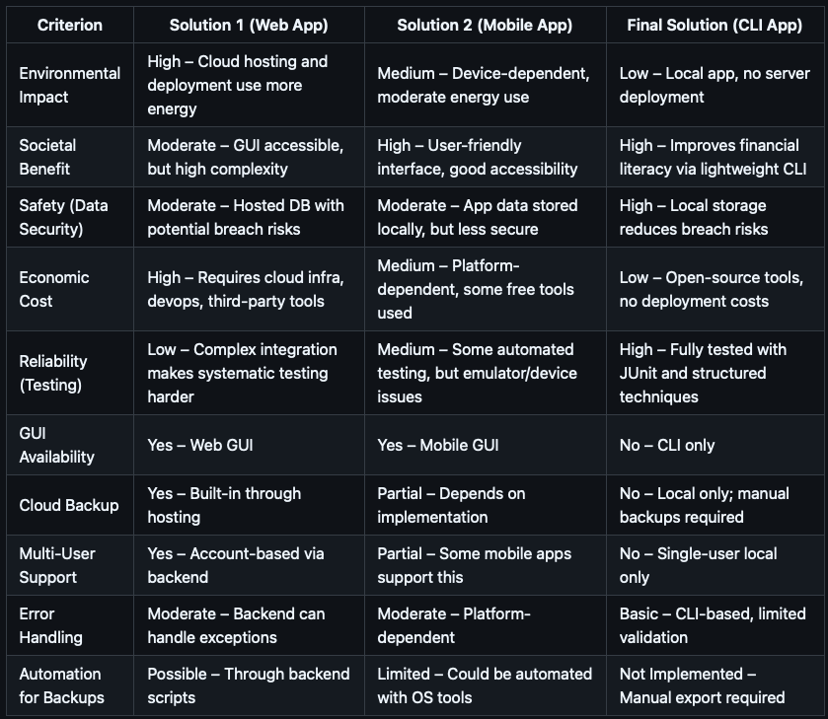
Final Comparison Table
Notes:
Simran list criterion, talk about solutions (keep it brief)

Slide 13
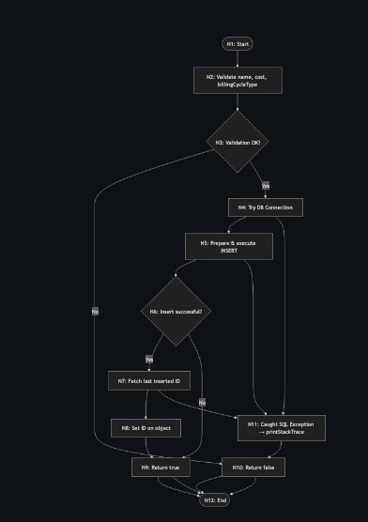
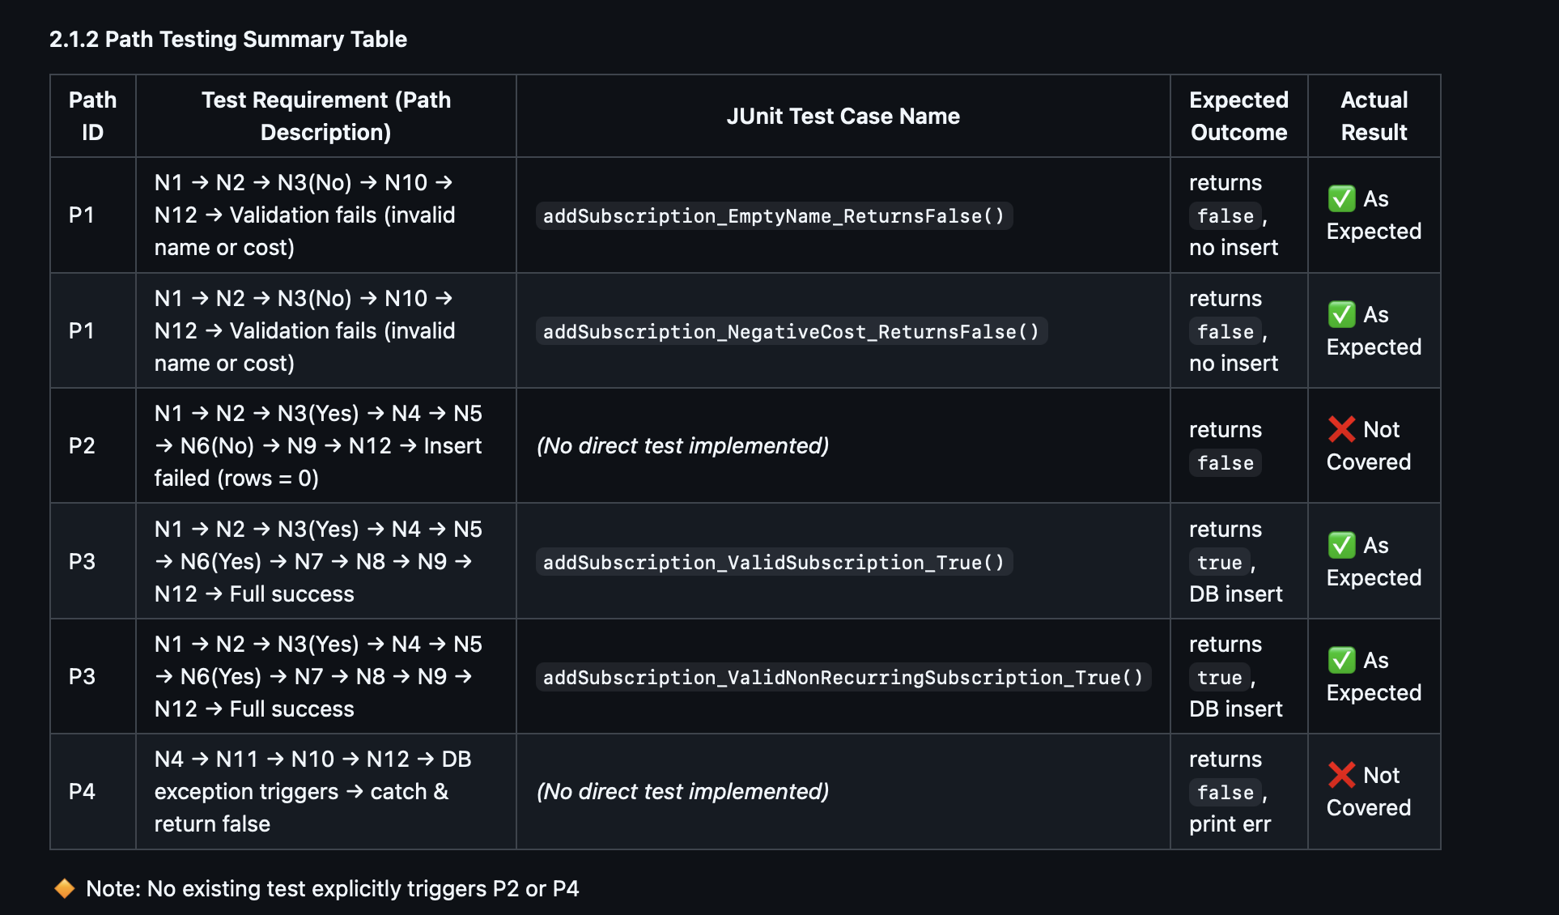
Testing and Demonstration: Specification Based
Path Testing
Target => db_module.addSubscription(subscription s)
Notes:
Go to github, testing.md, go one by one on what we are doing.

Slide 14
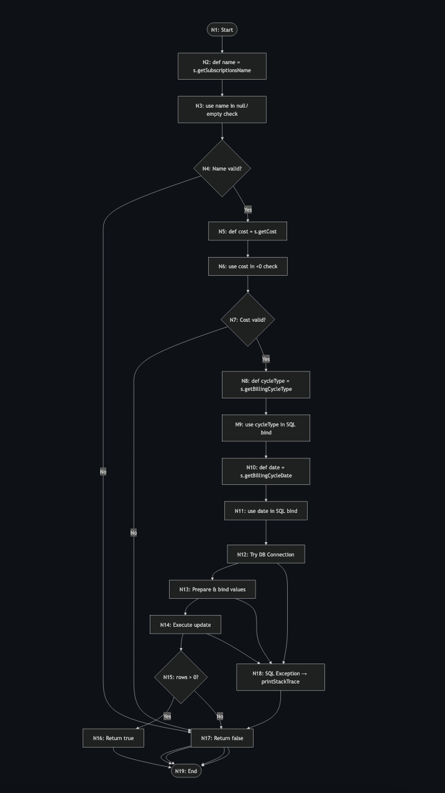
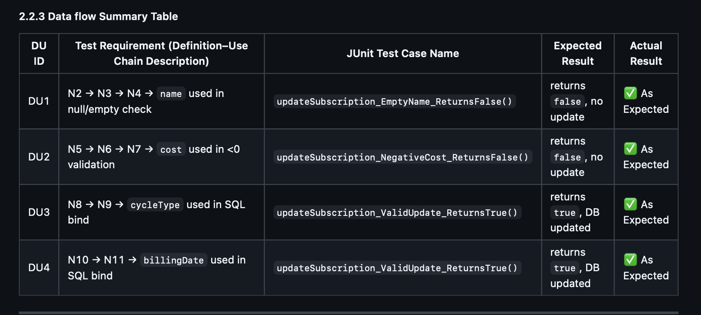
Testing and Demonstration: Specification Based
Data-Flow Testing
Target => db_module.updateSubscription(subscription s)
Notes:
Go to github, testing.md, go one by one on what we are doing.

Slide 15
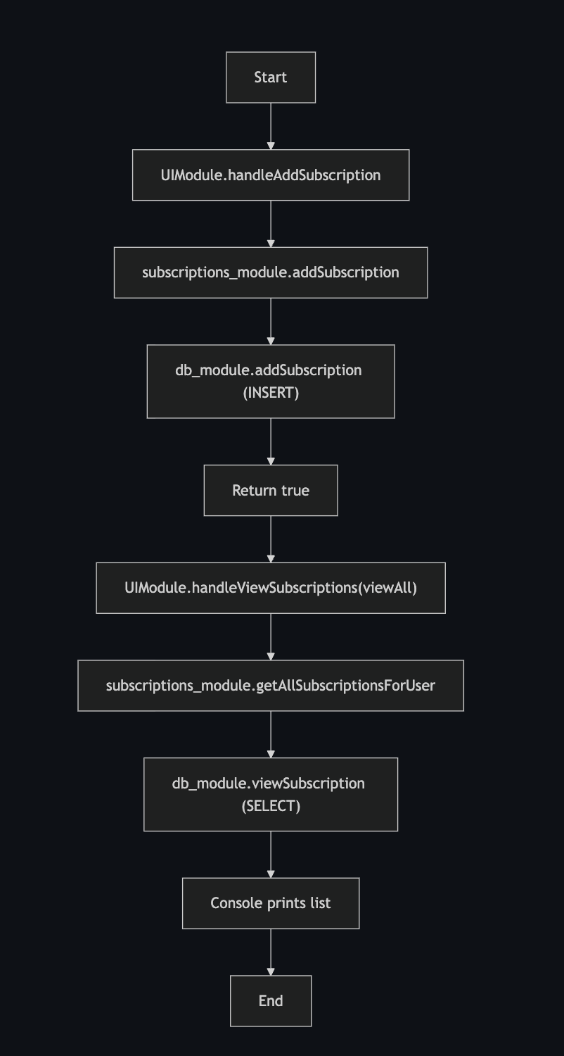
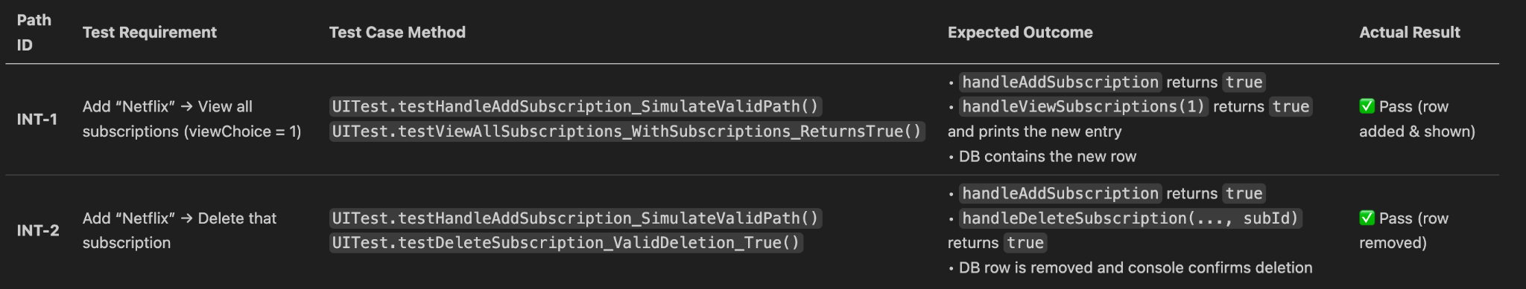
Testing and Demonstration: Integration Testing

Slide 16
Validation Testing

Slide 17
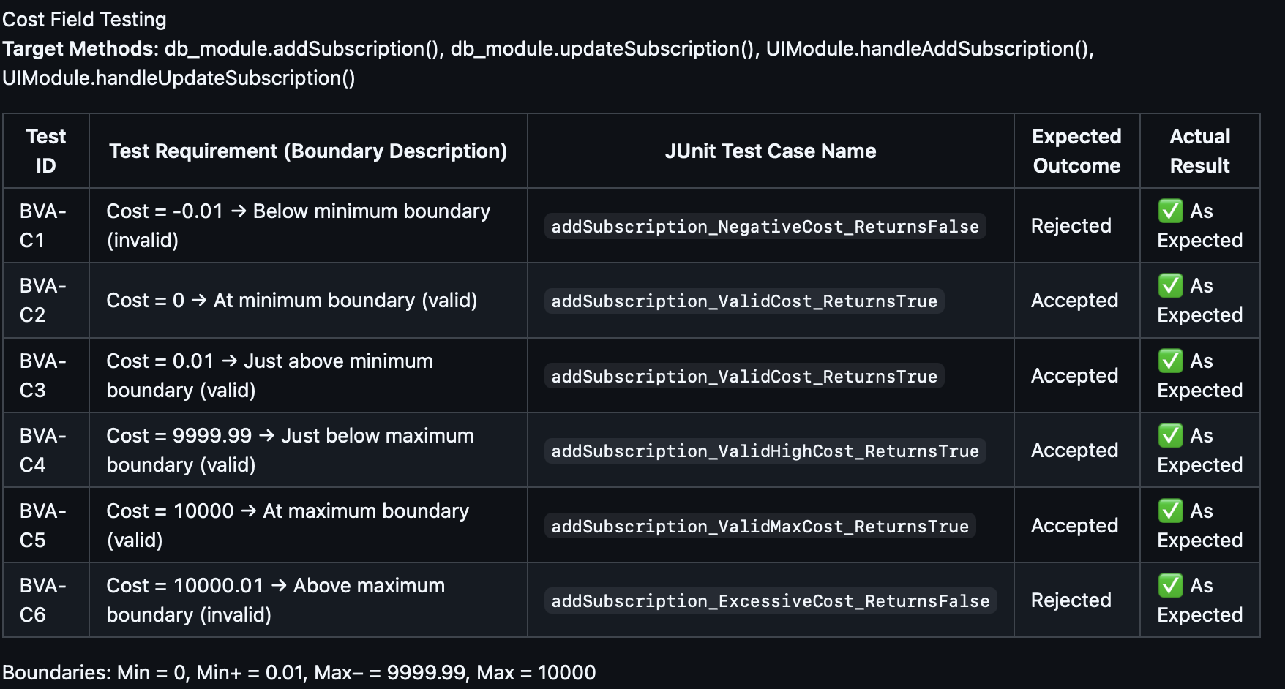
Boundary Value Analysis (addSubscription)

Slide 18
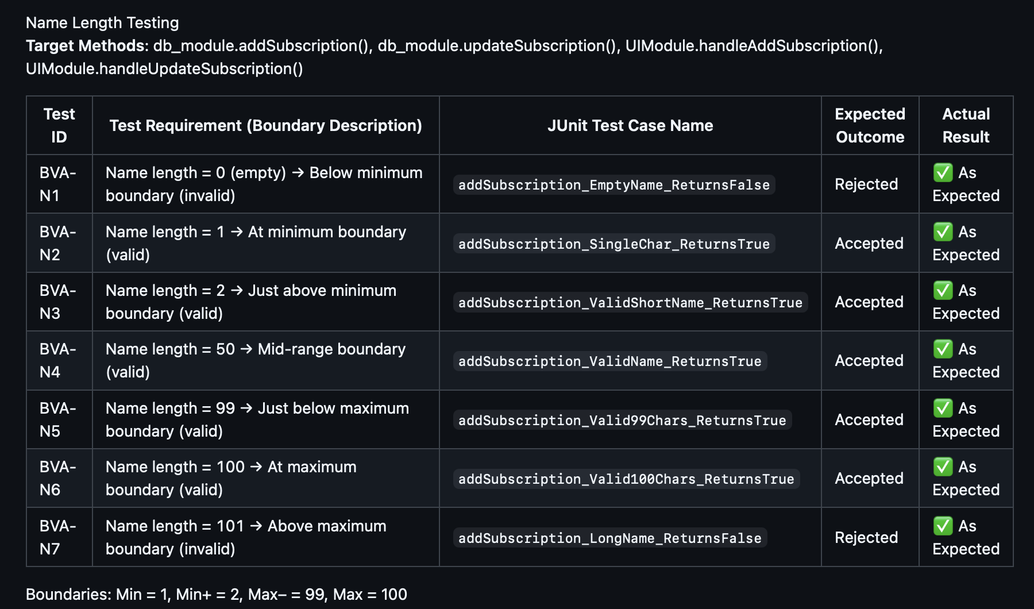
Boundary Value Analysis (addSubscription)

Slide 19
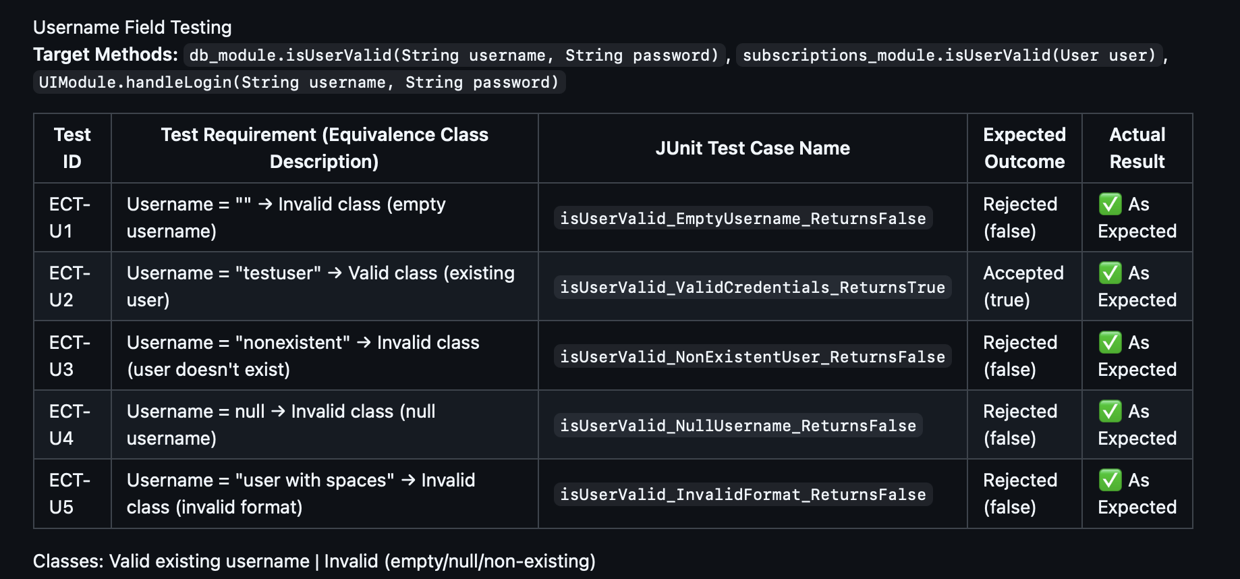
Equivalence Class Testing (User Authentication)

Slide 20
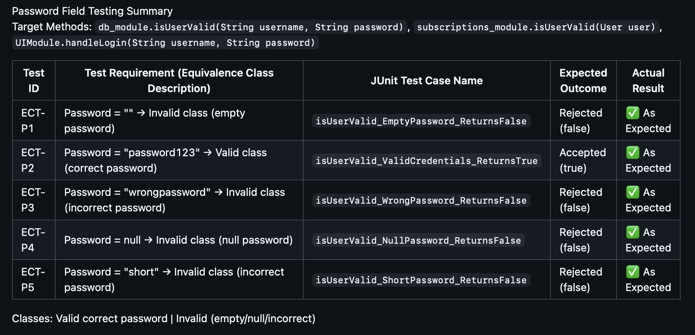
Equivalence Class Testing (User Authentication)

Slide 21
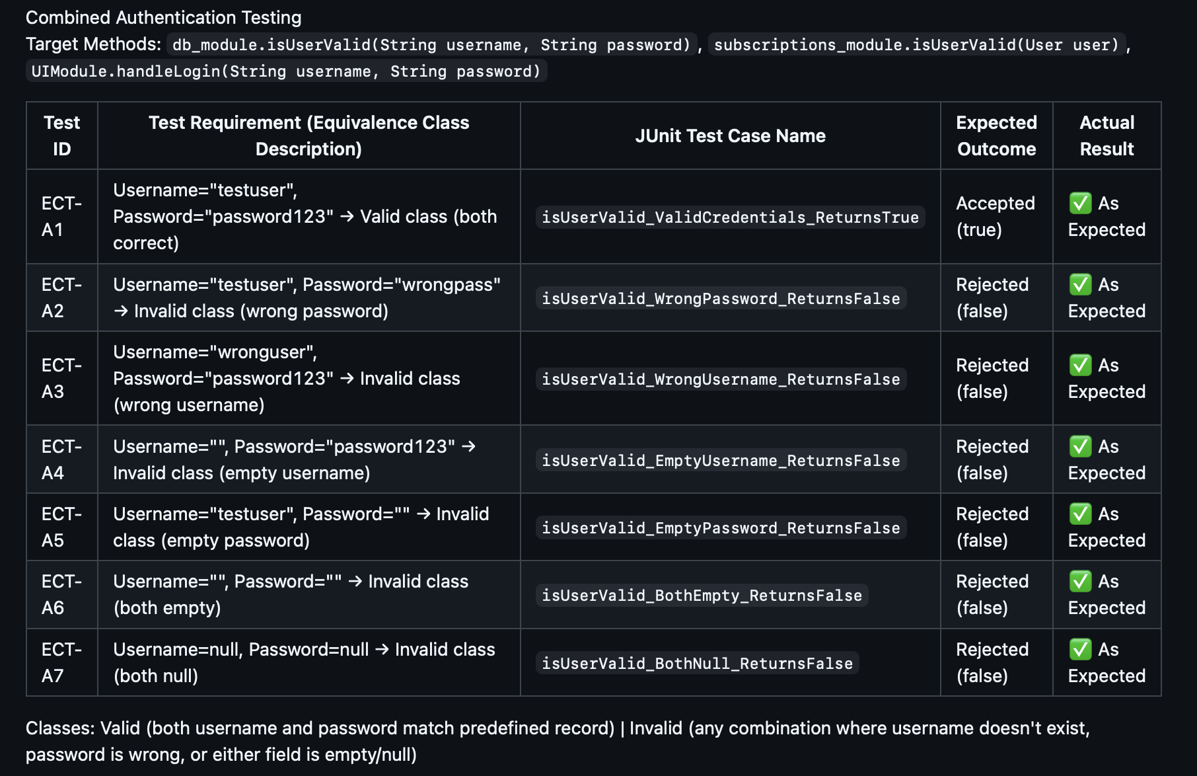
Equivalence Class Testing (User Authentication)

Slide 22
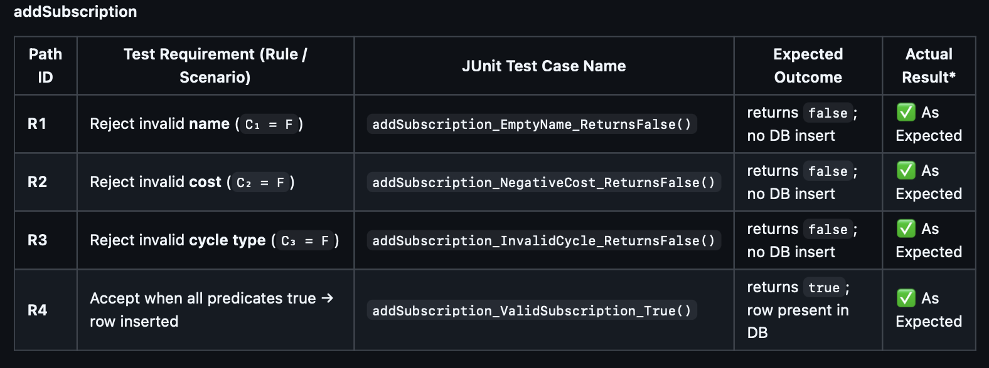
Decision Table Testing (addSubscription)

Slide 23
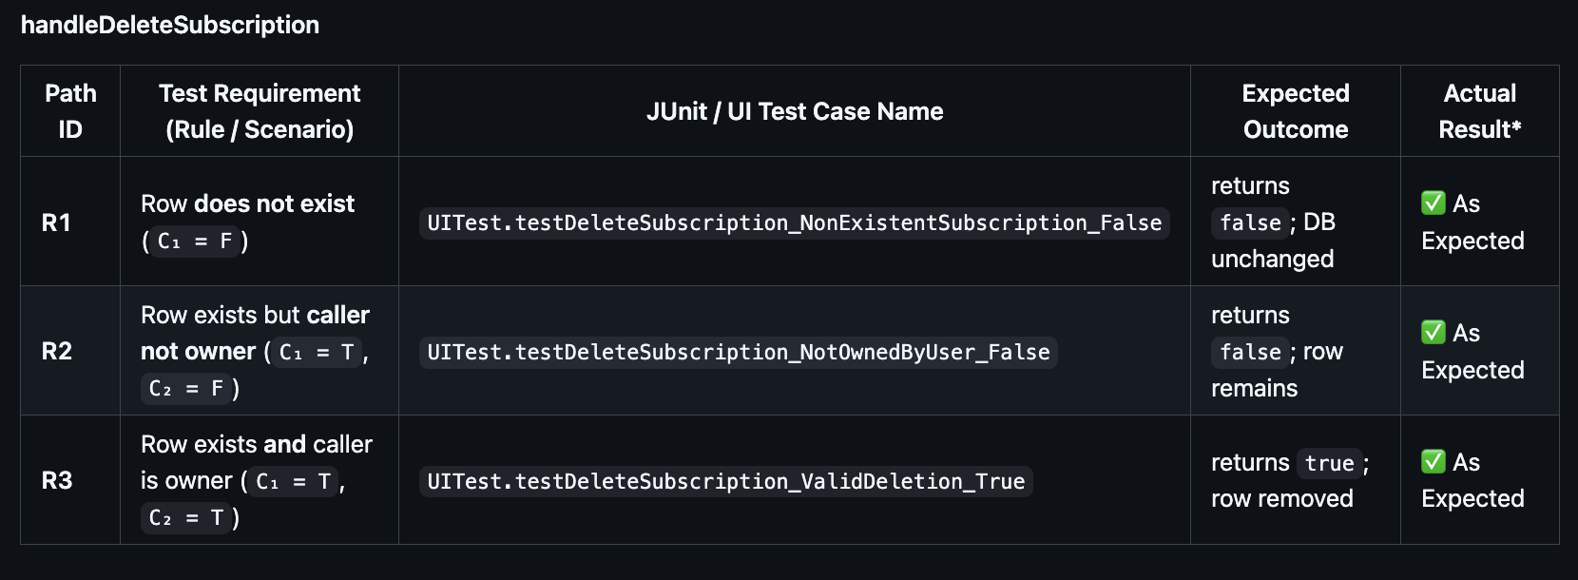
Decision Table Testing (handleDeleteSubscription)

Slide 24
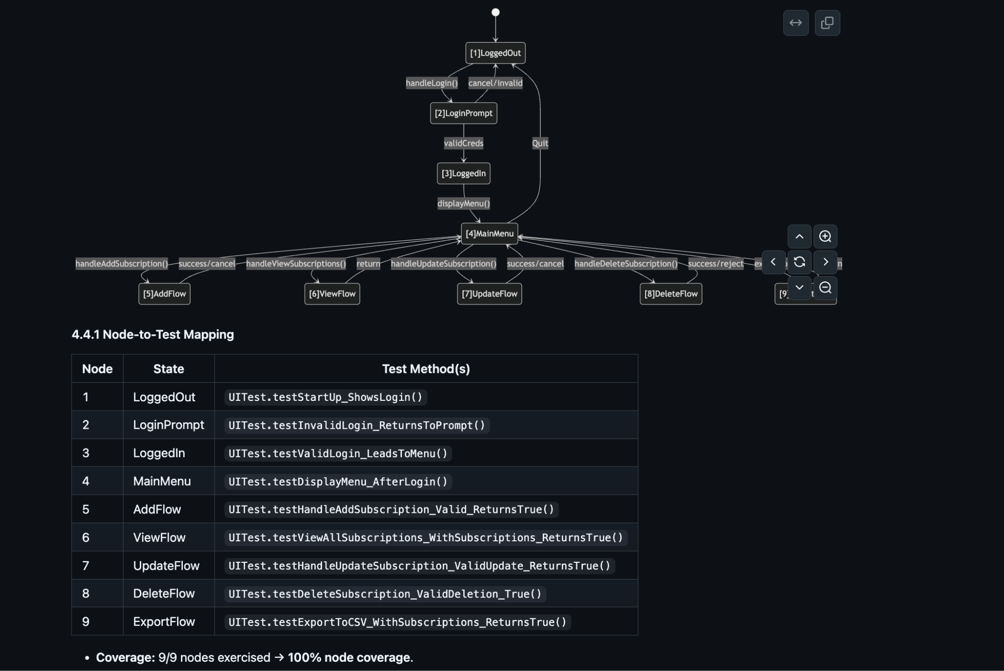
State Transition

Slide 25
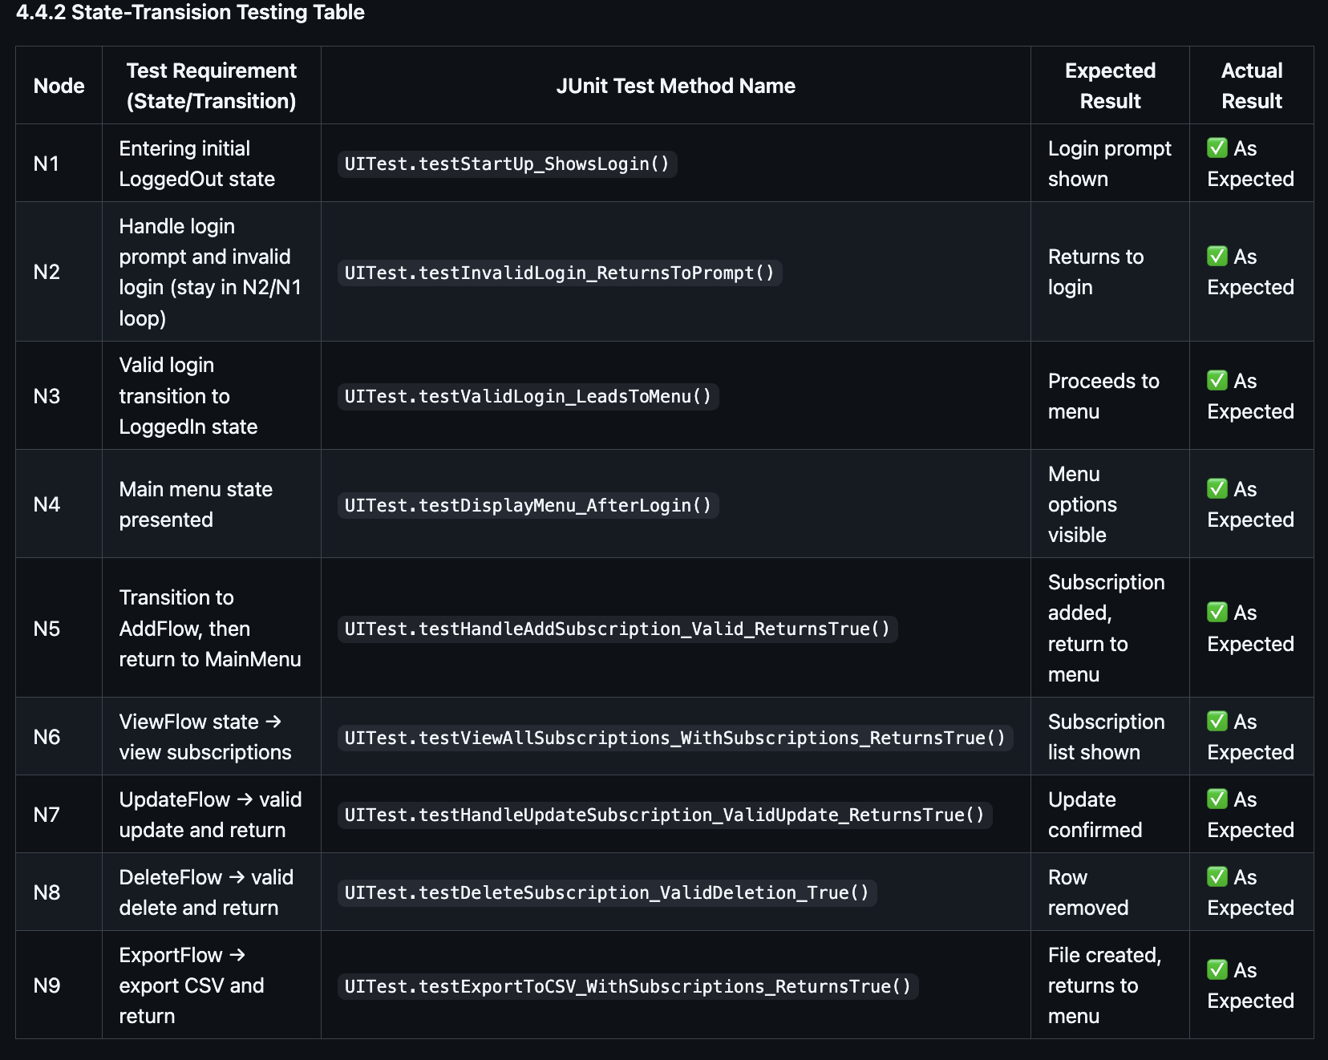
State Transition

Slide 26
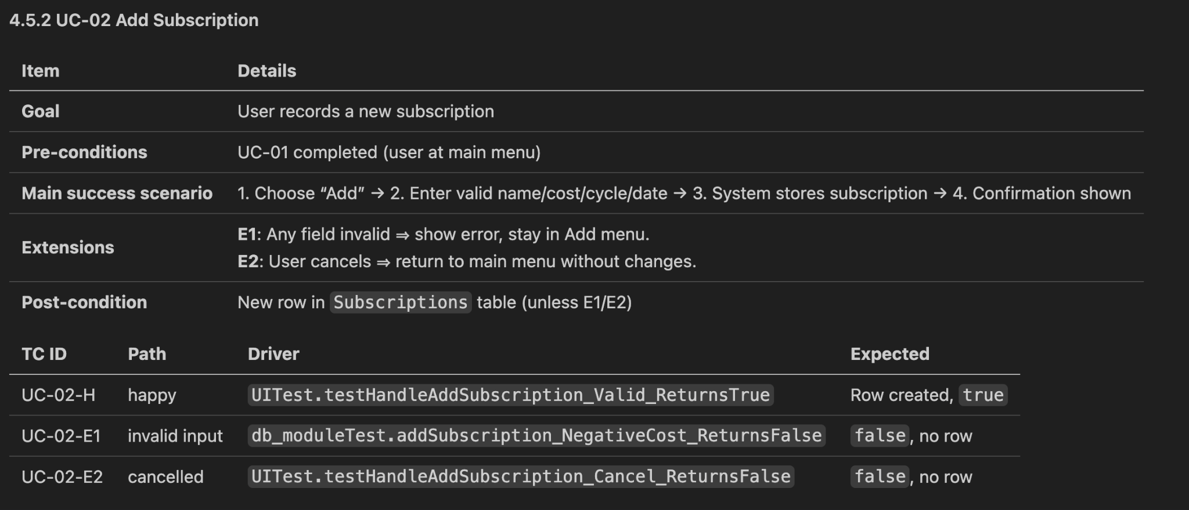
Use Case Table Testing (addSubscription)

Slide 27
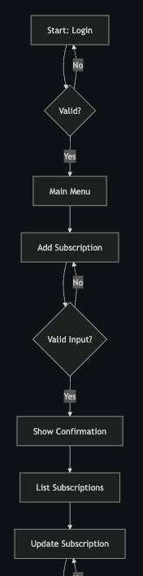
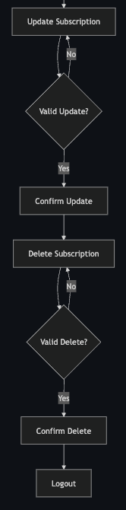
Use Case Testing

Slide 28
Application Demonstration
Testing Demonstration

Slide 29
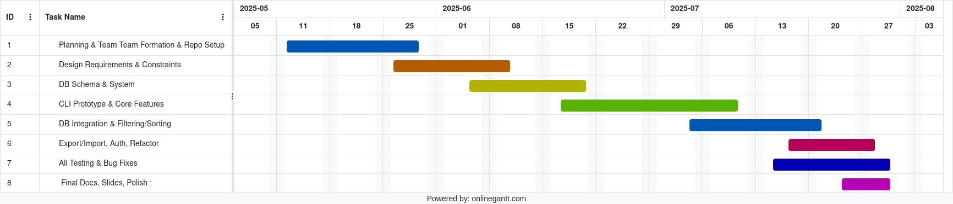
Project Management

Slide 30
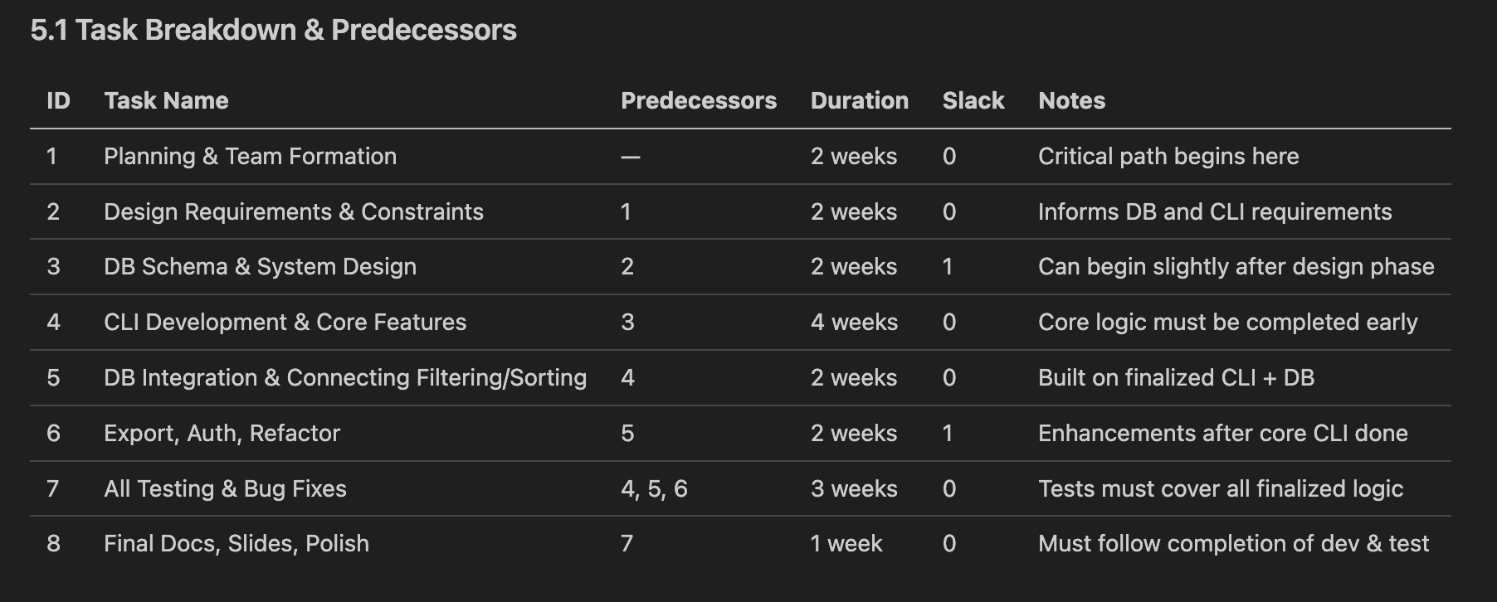
Project Management Table
Notes:
- Task 3 which is the db, and task 6 which is the export, auth, refactoring tasks, each have about 1 week slack, giving flexibility.
- All tasks have zero slack time.
- Critical Path: Task1->Task2->task4->task5->task7->task8

Slide 31
Conclusion
The NextPay subscription tracking application successfully achieved all primary design functions and objectives while satisfying the comprehensive testing requirements of ENSE 375. Our team brought their minds together to develop a fully functional Java Based CLI Application that addresses the core problem of subscription management thorough systematic software development and rigorous testing practices such as Test Driven Development (TDD). The key achievements include:
Efficiently adding, updating, deleting user subscriptions with completed CRUD functionality.
Managing user accounts.
Sorting subscriptions by billing dates in ascending or descending order.
Calculating and displaying subscription costs that occur monthly or yearly with comprehensive summaries.
Allowing users to export their subscription data to CSV format, for any external purposes.
Storing all data securely in a local SQLite database system
Providing an intuitive CLI for streamlined subscription management.
Notes:
Muhammad

Slide 32
Future Work
While the final solution meets the current needs of individual subscription management, there are opportunities for future improvements:
Web Application Development: Develop a full-stack web application using Spring Boot backend with REST APIs and React frontend for cross platform accessibility and modern user experience.
Multi User Support: Enhancing the architecture to support multiple accounts with shared subscription management and collaborative budgeting features.
Advanced Analytics: Extend the analytics to include more details of subscription habits. Adding notification support to email and SMS for subscription renewals can also be implemented.
Subscription Category Management: Build upon the current subscription data model to include categorization features, allowing users to group subscriptions and view category-based spending summaries similar to the existing monthly summary feature.
AI Integration: Implement machine learning algorithms to analyze user subscription patterns and provide personalized financial education recommendations.
Notes:
Muhammad

Slide 33
Thank You!
-NextPay Team-
Notes:
Muhammad

